Slide 1

Smart Agricultural Monitoring System for Optimized Crop Growth Using Soil Moisture Sensor and IoT Integration
ECA1402- Embedded systems for Edge AI
Supervisor: Dr C Senthil kumar
Presented By: U.Maheshware Reddy(192210540)
D V Sai kumar(192372321)

Slide 2
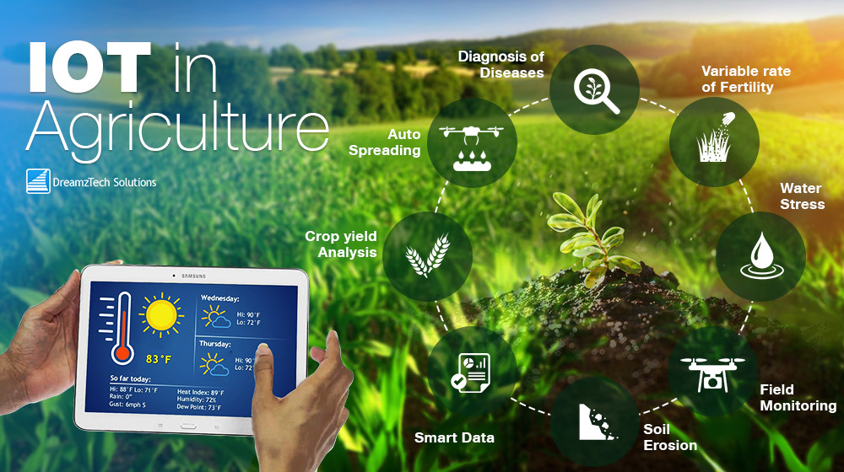

Slide 3

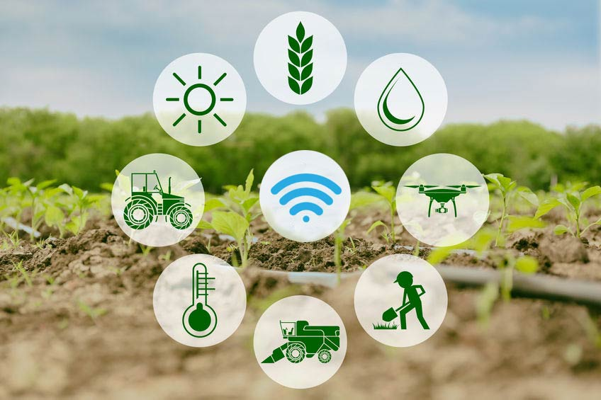

Introduction:
Agriculture is the backbone of our society, providing food and sustenance for billions of people around the world.
However, traditional farming methods often rely on manual monitoring and decision-making, which can lead to reduced crop yields, inefficient resource usage, and decreased profitability.

Slide 4
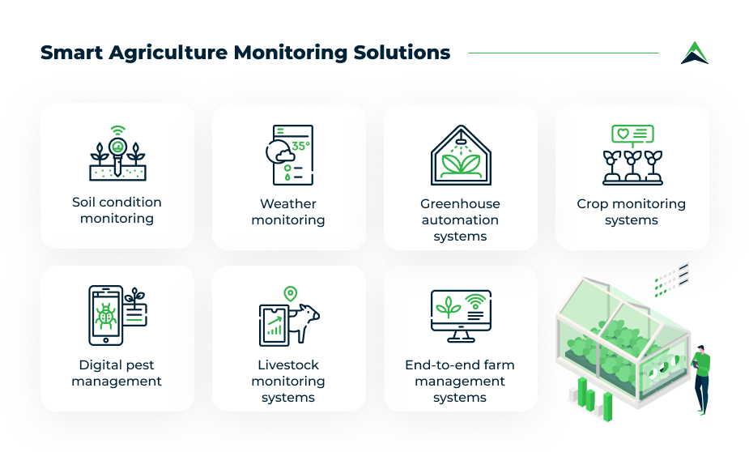

Slide 5
Solution:
Smart Agriculture Monitoring System:
In this presentation, we will introduce an innovative solution that leverages Internet of Things (IoT) technology and data analytics to optimize agricultural practices.
Our Smart Agriculture Monitoring System enables farmers to remotely monitor soil moisture, temperature, and humidity levels, receive automated readings, and make data-driven decisions to enhance crop yields and resource efficiency.

Slide 6
Objectives:
Soil Moisture
Humidity
Temperature

Slide 7
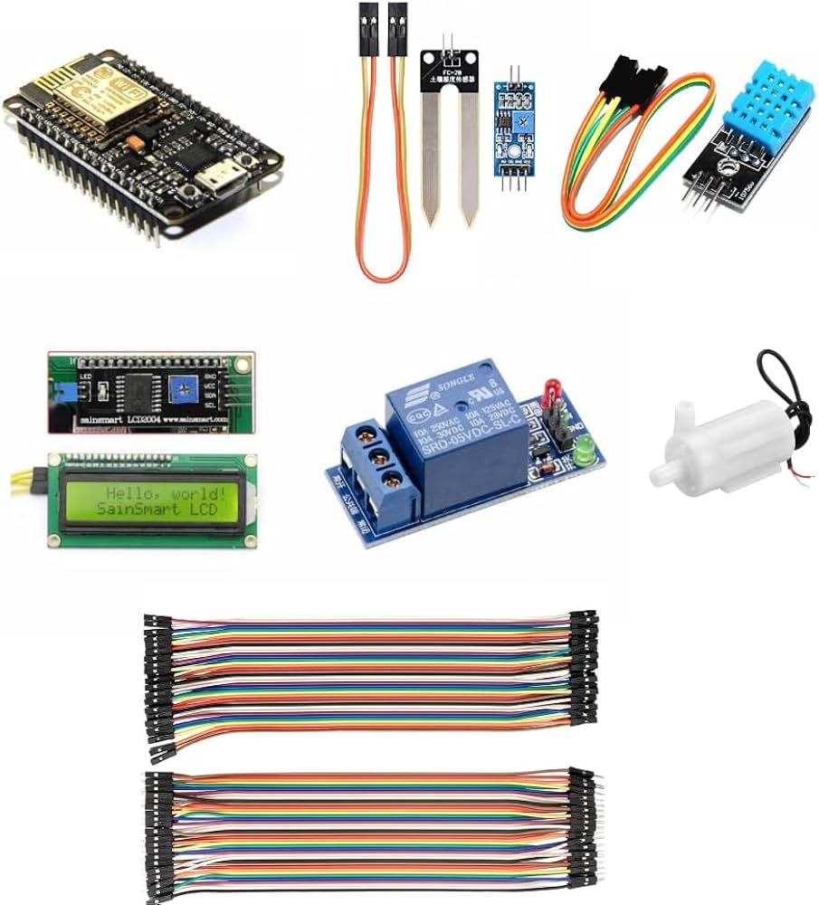
SYSTEM COMPONENTS :
HARDWARE REQUIREMENTS:
ESP8266
Soil Moisture Sensor
DHT11 Sensor
Connecting Cable
SOFTWARE REQUIREMENTS:
Arduino IDE
Programming Language – C++ Language
BLYNK App

Slide 8
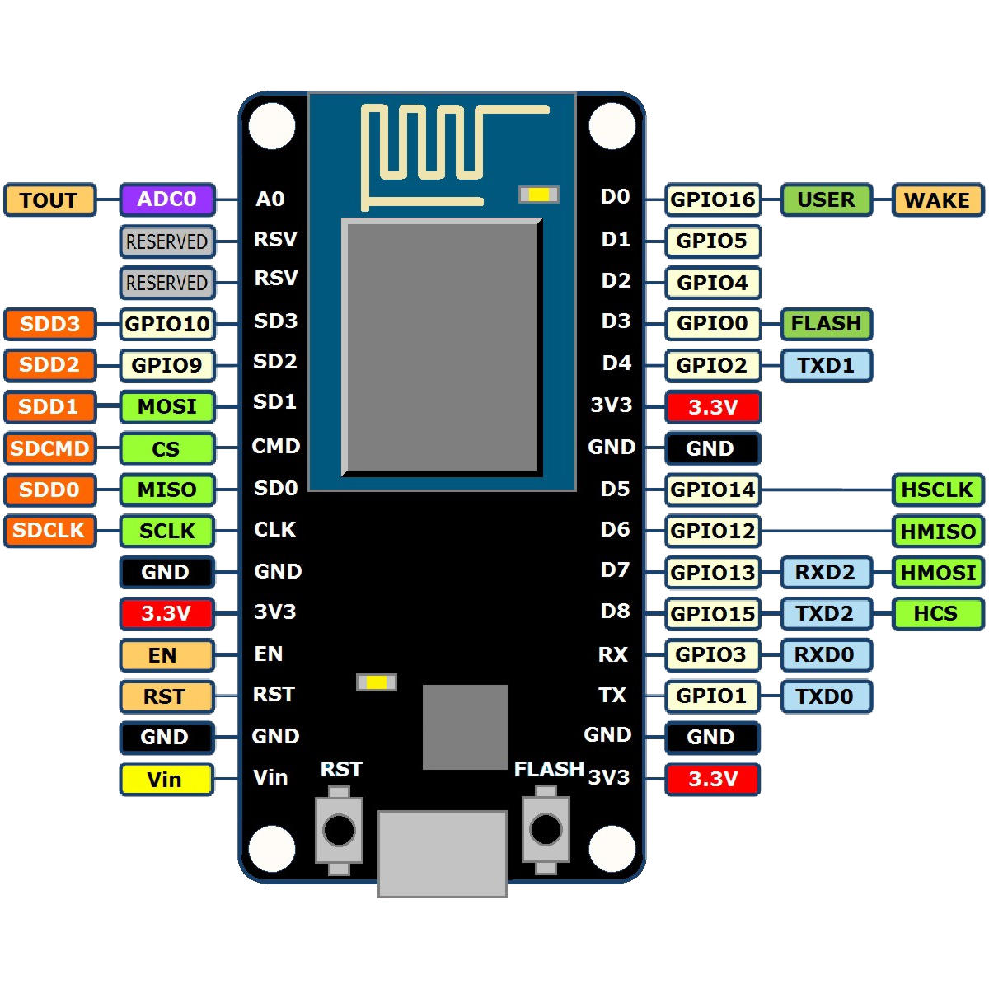
ESP8266:
The ESP8266 is a low-cost, Wi-Fi-enabled microcontroller that can be used to connect sensors and devices to the internet.
In this project, the ESP8266 is used to read data from the soil moisture sensor and DHT11 sensor, and send it to a server or cloud platform for monitoring and analysis.

Slide 9
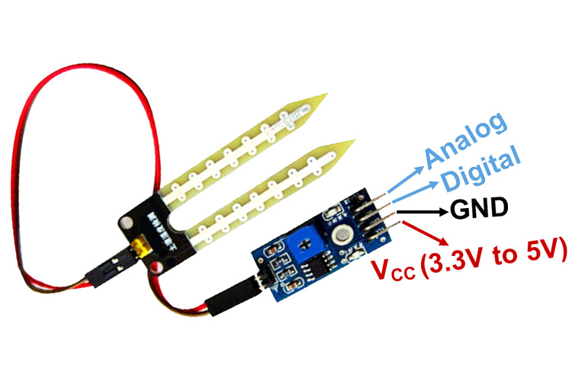
Soil Moisture Sensor:
The soil moisture sensor is used to measure the moisture levels in the soil.
It consists of two probes that are inserted into the soil, and a sensor board that reads the electrical conductivity of the soil.
The sensor board sends an analog signal to the ESP8266, which converts it to a digital value.

Slide 10
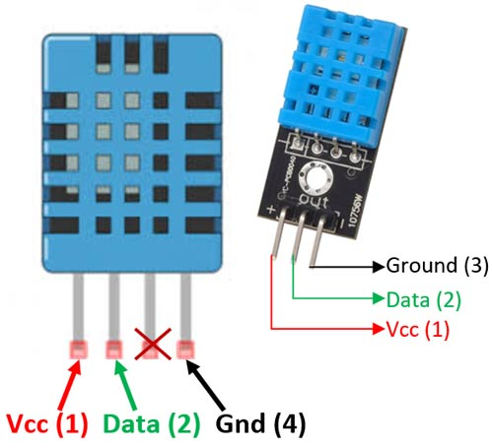
DHT11 Sensor :
The DHT11 sensor is used to measure the temperature and humidity in the air.
It consists of a temperature sensor and a humidity sensor, and sends digital signals to the ESP8266.
The DHT11 sensor is connected to the ESP8266 as follows:
- VCC to 3.3V
- GND to GND
- OUT to any digital pin (e.g., D1)

Slide 11
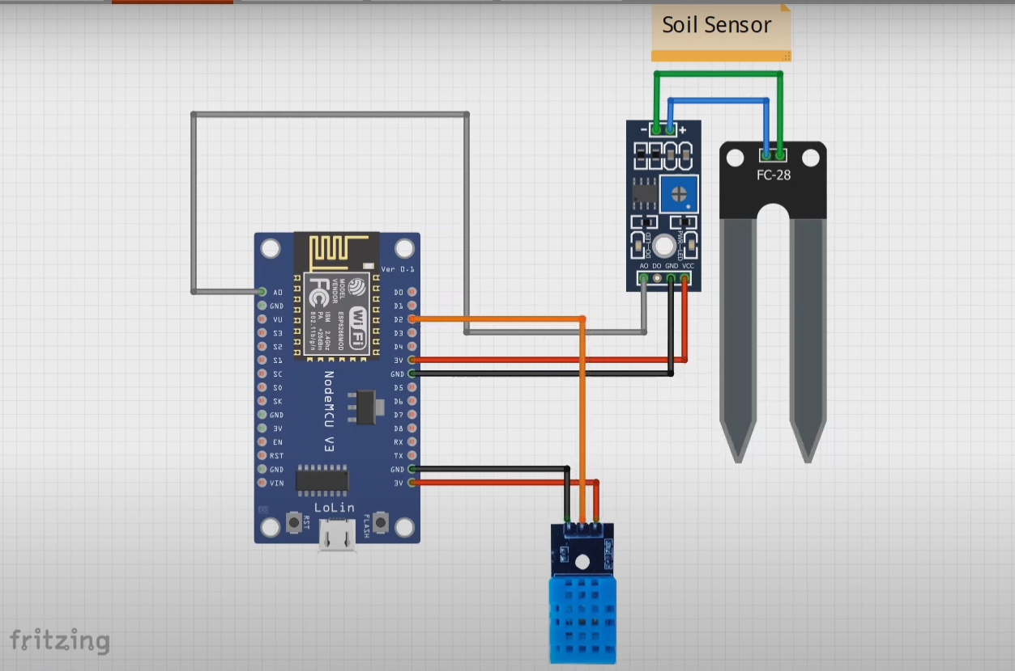
CIRCUIT DIAGRAM:

Slide 12
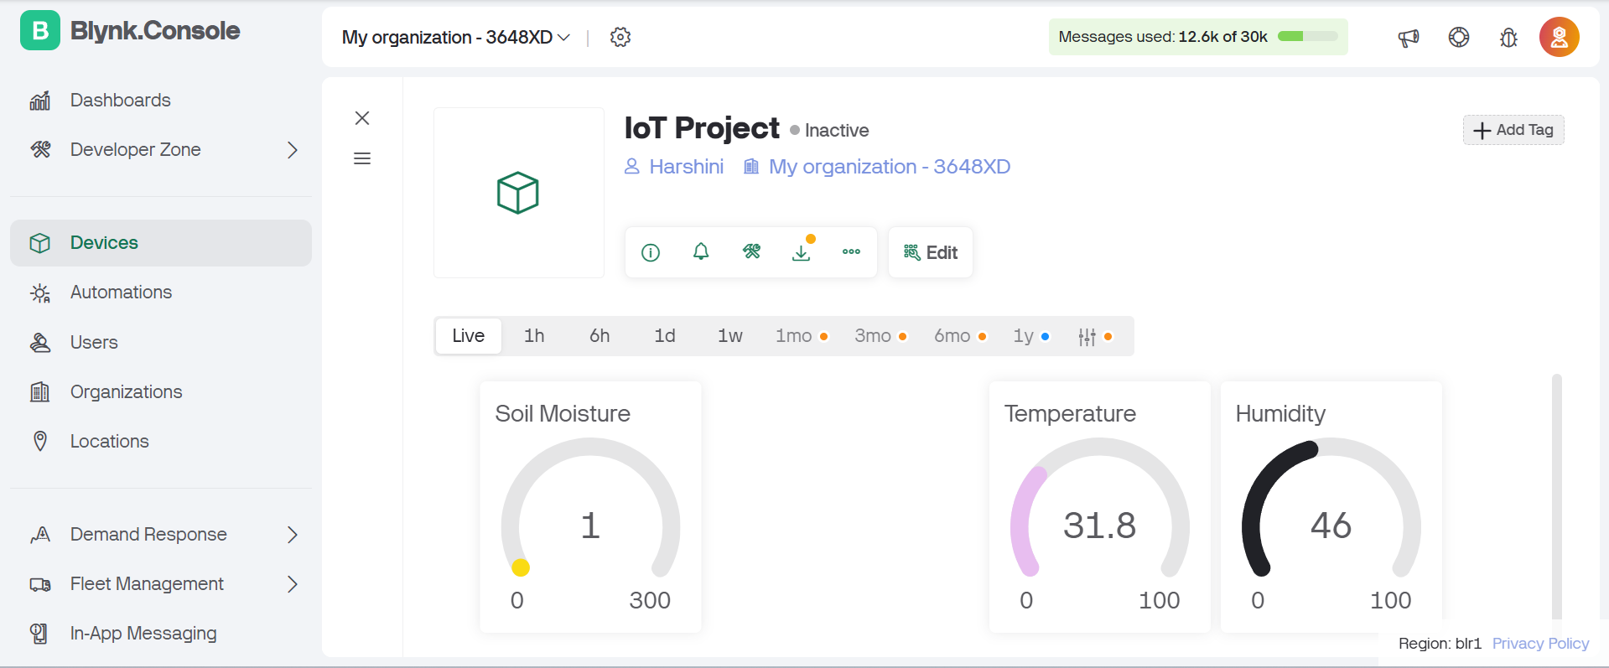
BLYNK APP:
Login to blynk.cloud website and create new template for Soil Monitoring System.
Create a web dashboard for soil moisture, humidity and temperature using widgets.
We will get template Id, template name, authentication token.

Slide 13
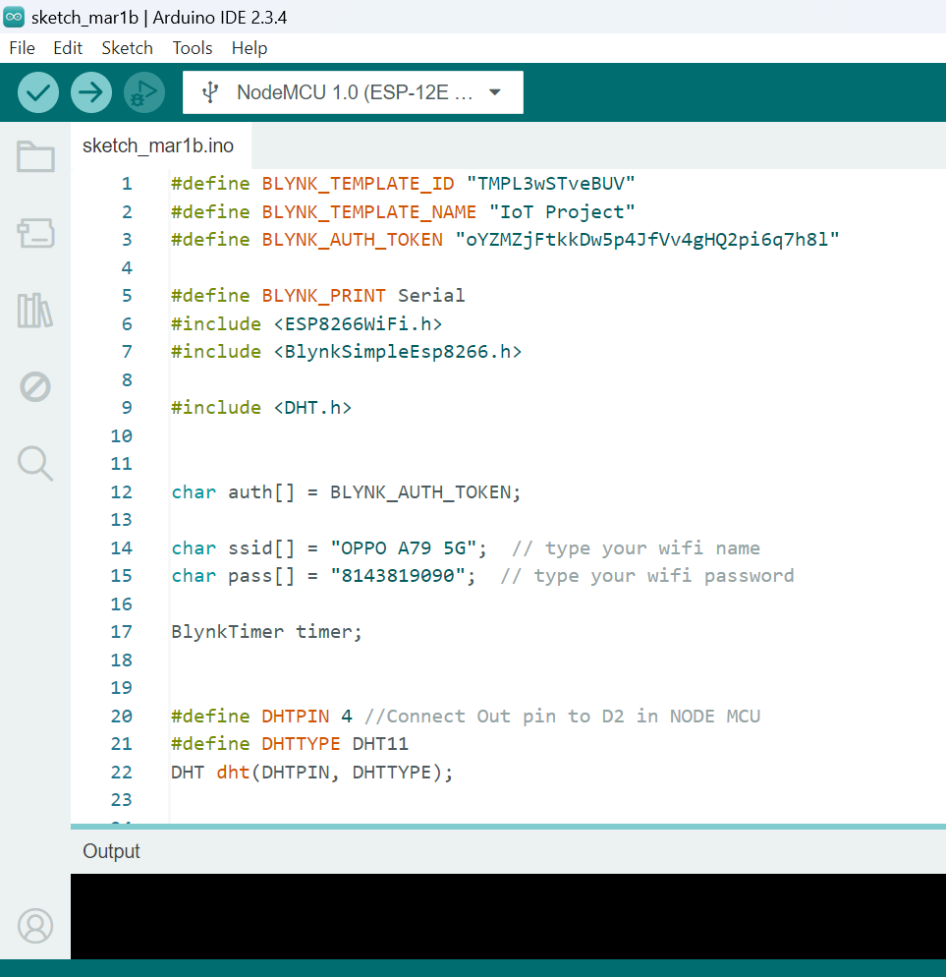
Arduino:
Paste the details in our Arduino program.
Enter Wi-Fi username and password.
Select the board ESP8266 and NodeMCU 1.0.
Now select the port and upload the program to the board.

Slide 14
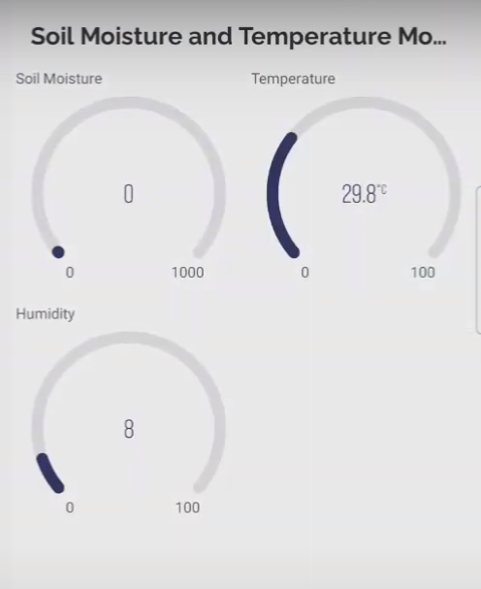
BLYNK Mobile dashboard:
Select the template we created in web dashboard.
Add gauge widgets for soil moisture, humidity and temperature.
Select data streams for all three widgets.
We can see the output in the web dashboard.

Slide 15
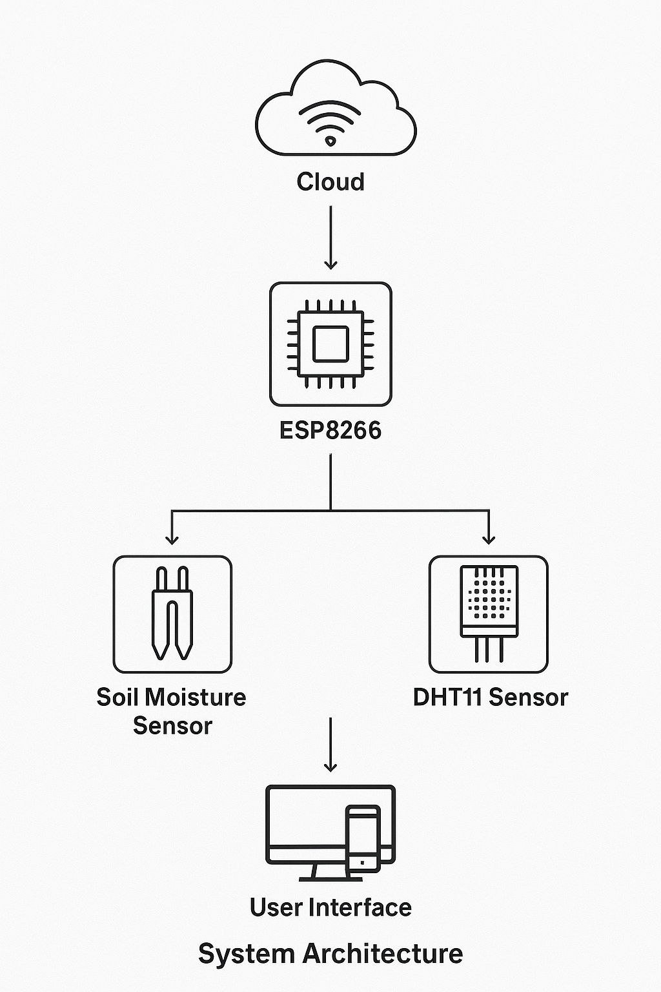
How it works:

Slide 16
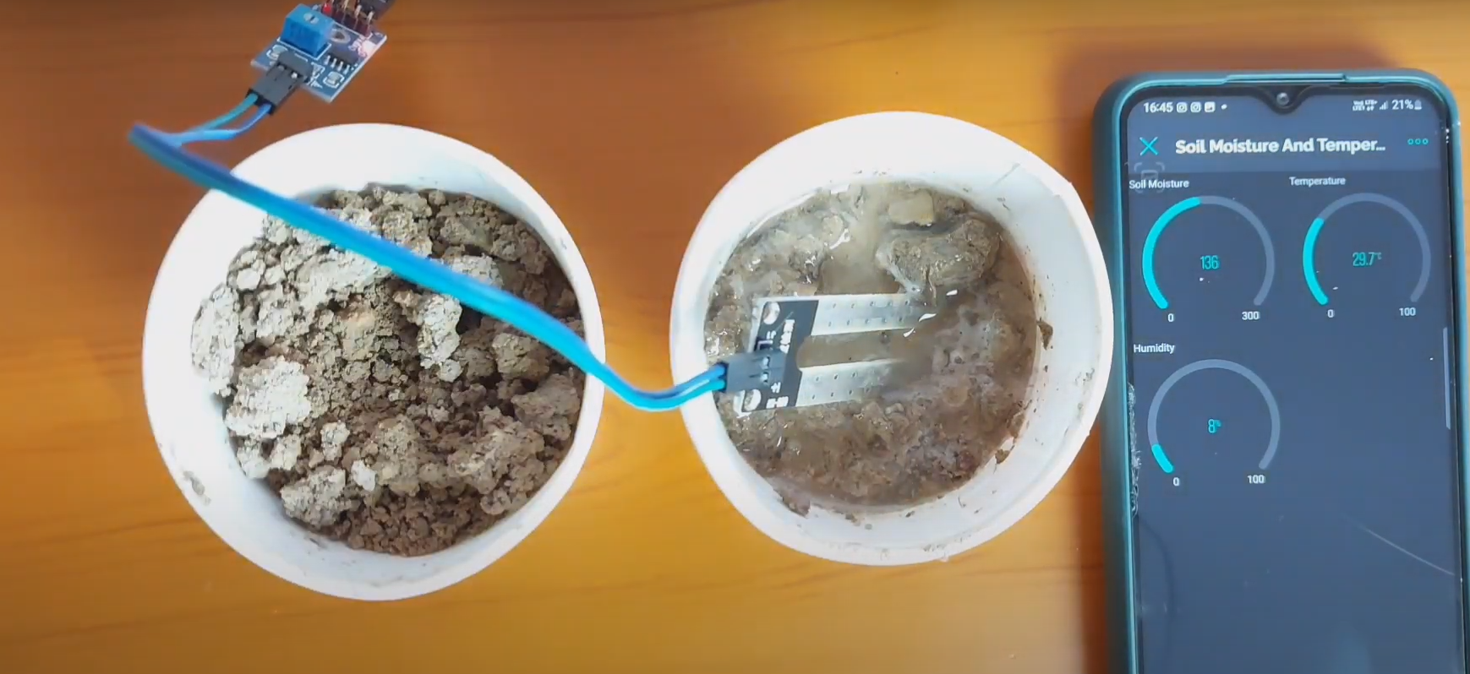
Project Demo :

Slide 17
CONCLUSION :
Smart Agriculture Monitoring System:
- Revolutionizing farming practices through IoT and data analytics.
- Optimizing crop growth, reducing waste, and enhancing yields.
- Enhanced food security, livelihoods, promoting sustainable agriculture.
"Technology is the key to unlocking a more efficient, productive, and sustainable agricultural sector."

Slide 18
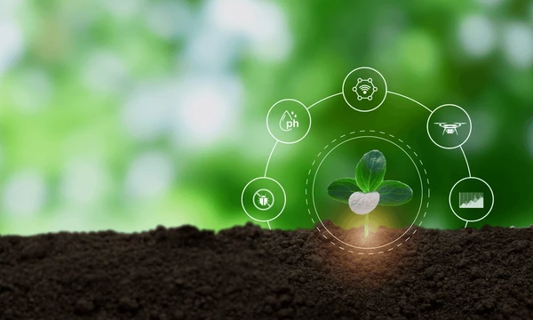

Thank you!

